Slide 1
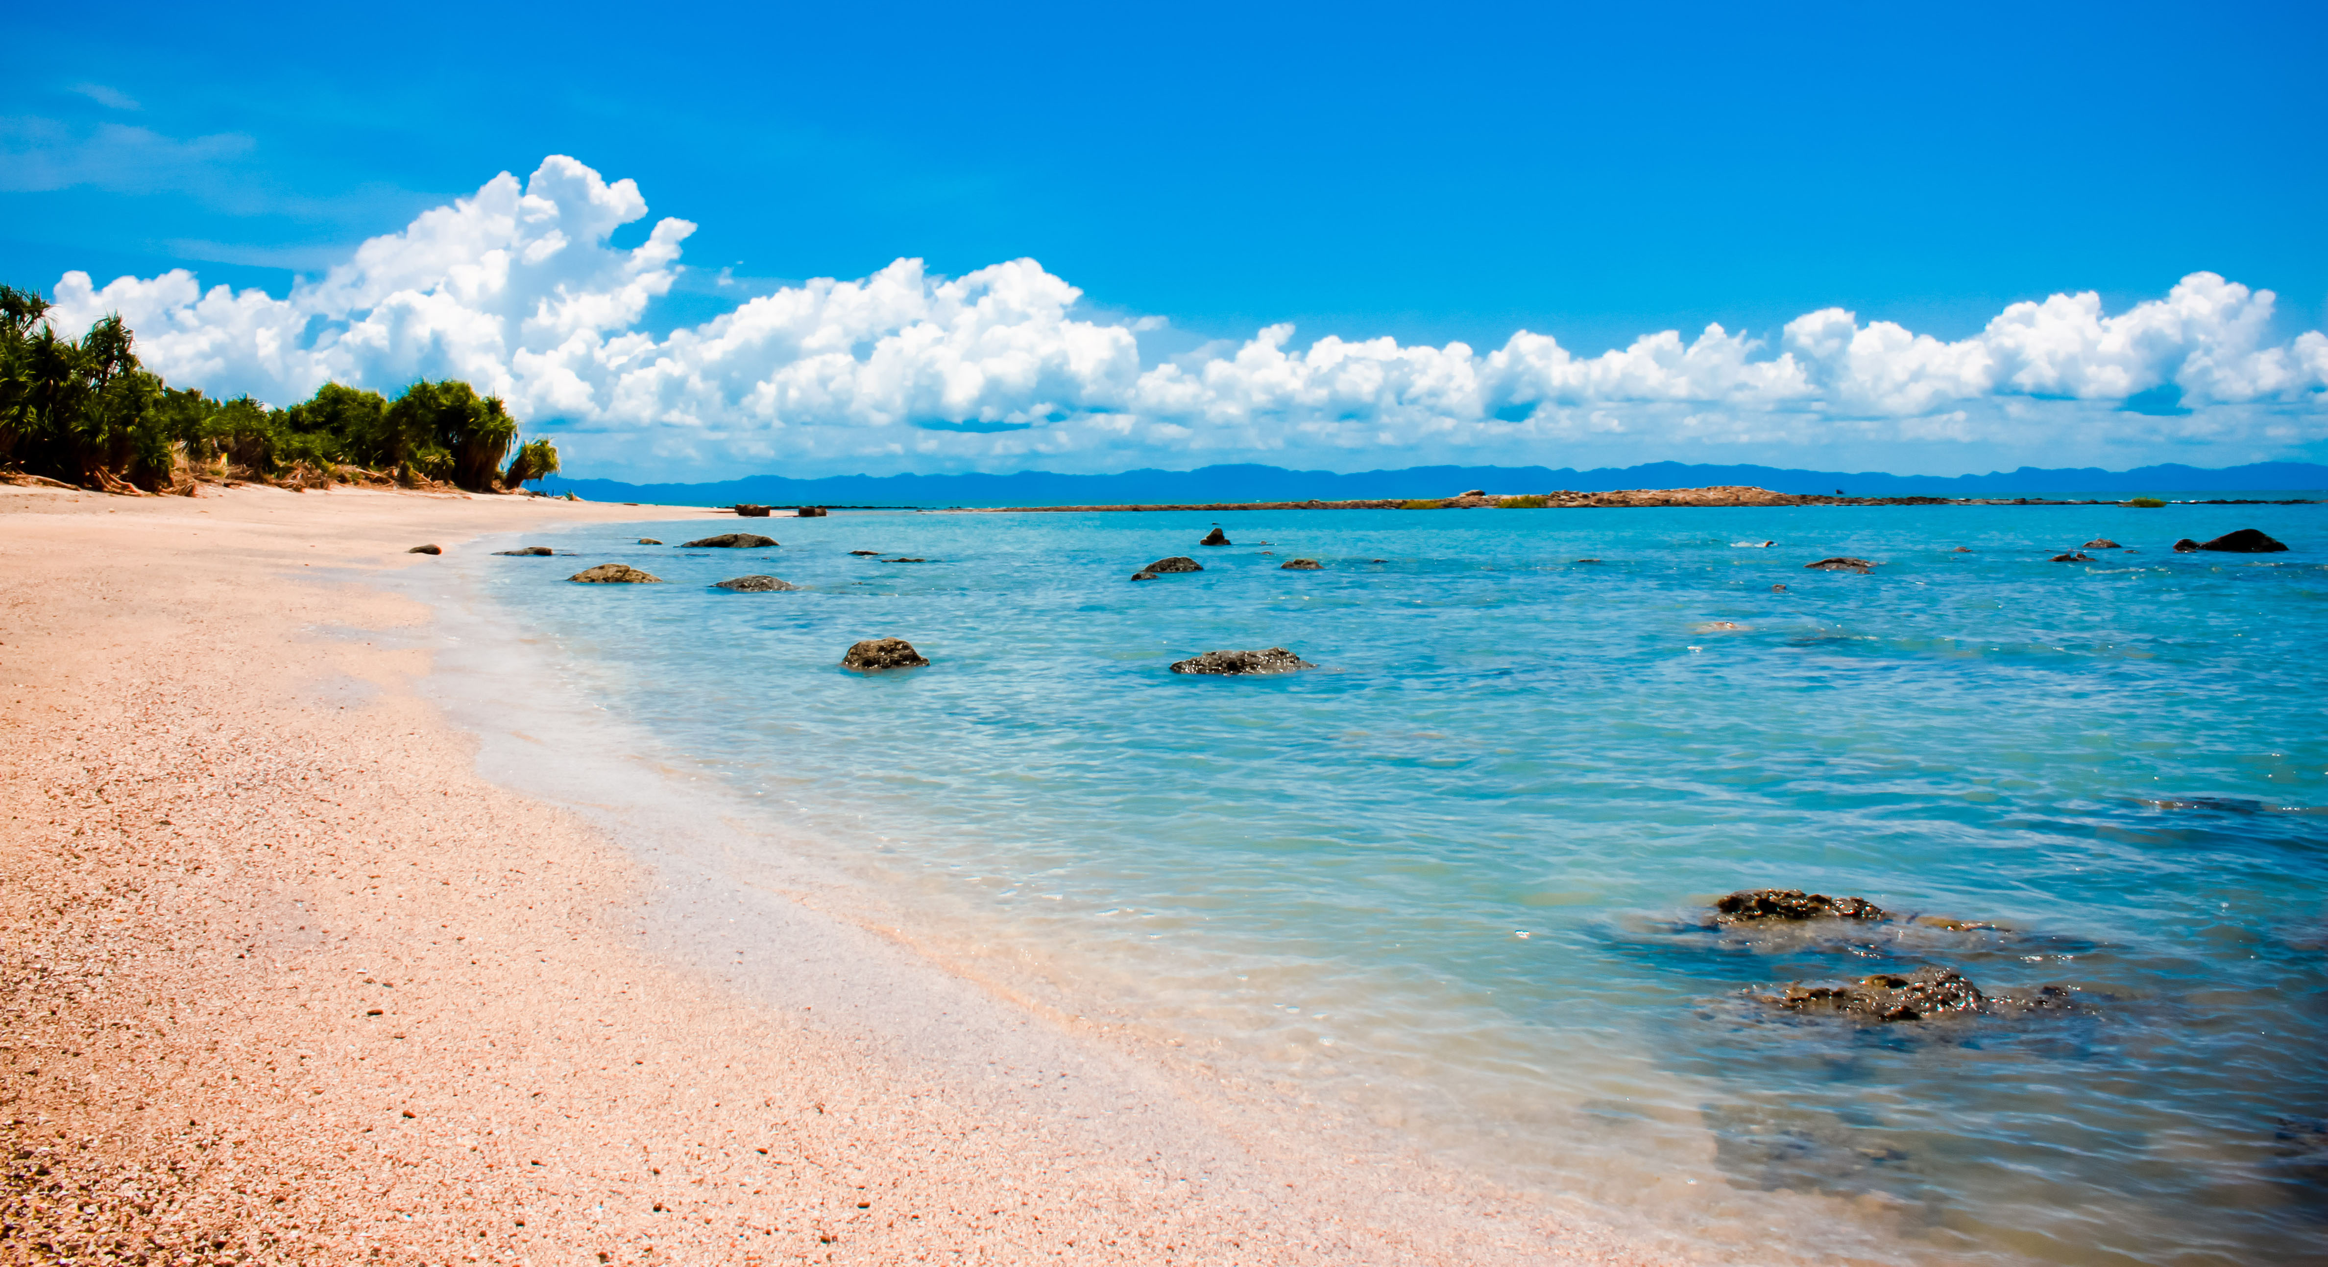
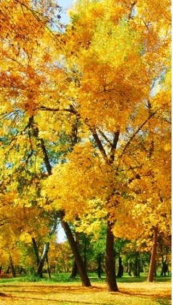
Welcome
Note: Click on Welcome

Slide 2
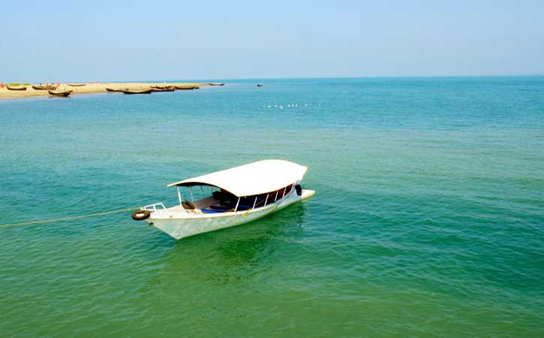


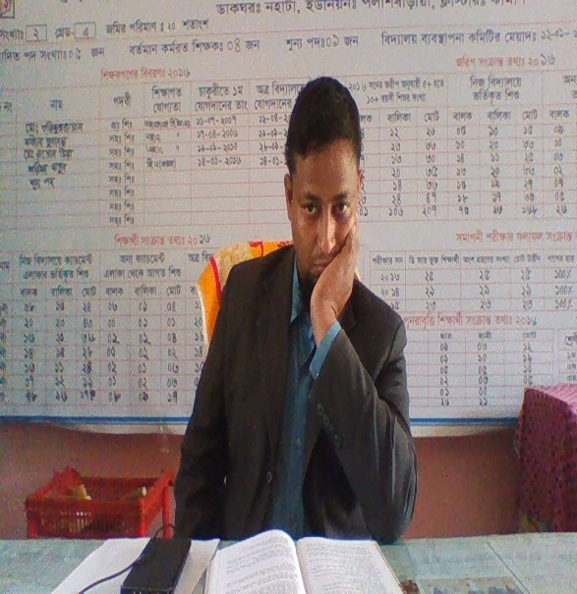
Introduction
Md. Tariquzzaman,
Head Teacher
Jokar govt. primary school,
Mohommadpur ,Maagura
Email: tareqht1977@gmail.com

Slide 3
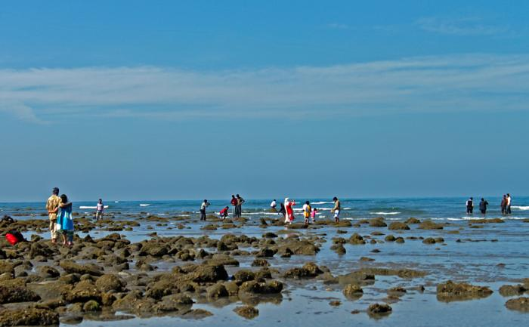
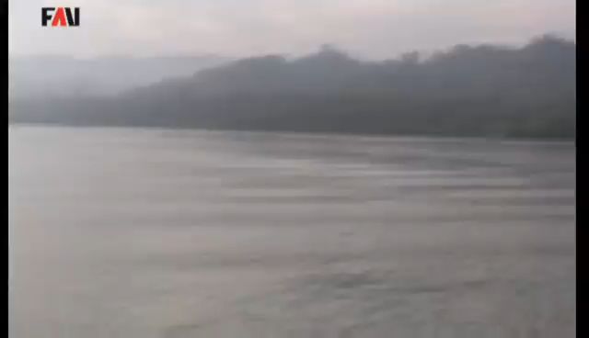
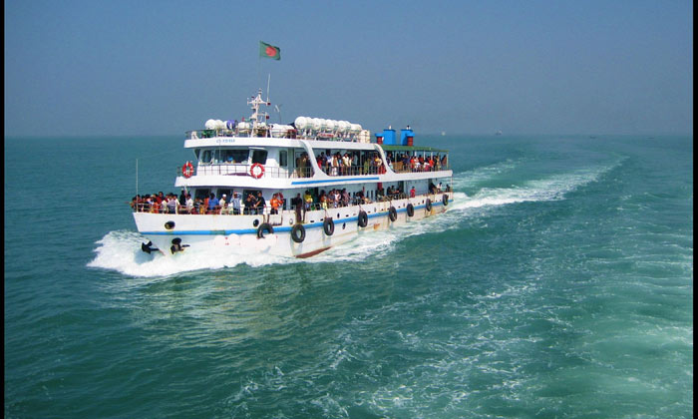
Safe learning environment
By watching video clips

Slide 4
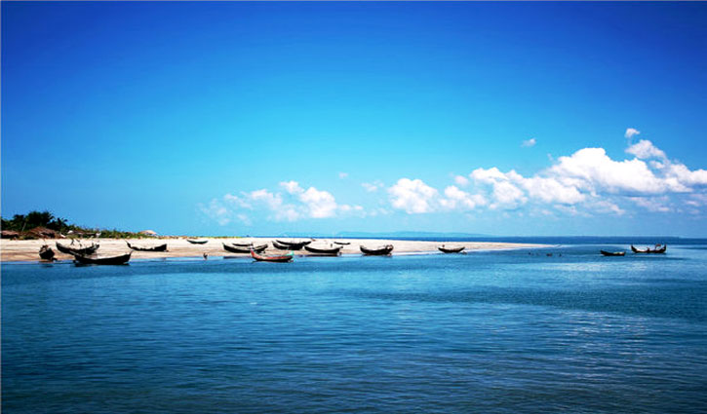
Today’s Lesson
Lesson: 16
How Far Is St. Martin`s
Unit: A
Page: 56
Note: Click on Today’s Lesson

Slide 5
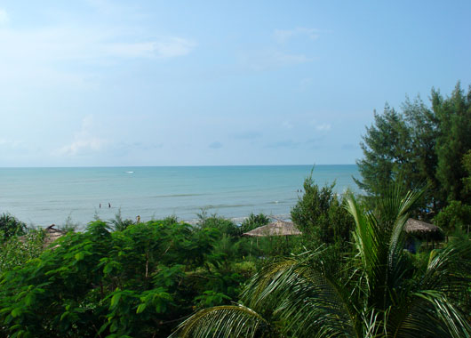
Learning Outcomes
Students will be able to:
1.Read the lesson with proper pronunciation stress and intonation .
2.Take part in a conversations.
3. To do task with instruction.
Note: Click on Learning Outcomes

Slide 6
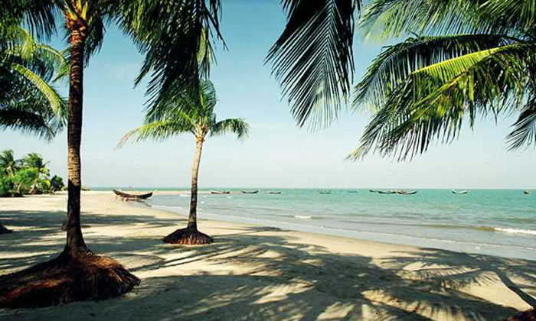
Declaration of Title
How Far Is St. Martin`s ?
Note: Click on Declaration of Title

Slide 7
Presentation
Look at the picture
Main tourist spots in Bangladesh
Cox’s Bazar
Note: Click on Main tourist spot in Bangladesh

Slide 8
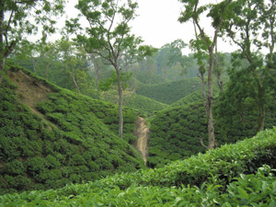
Tea Garden in Srimangal

Slide 9
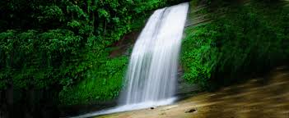
Madhabkhundu waterfalls

Slide 10
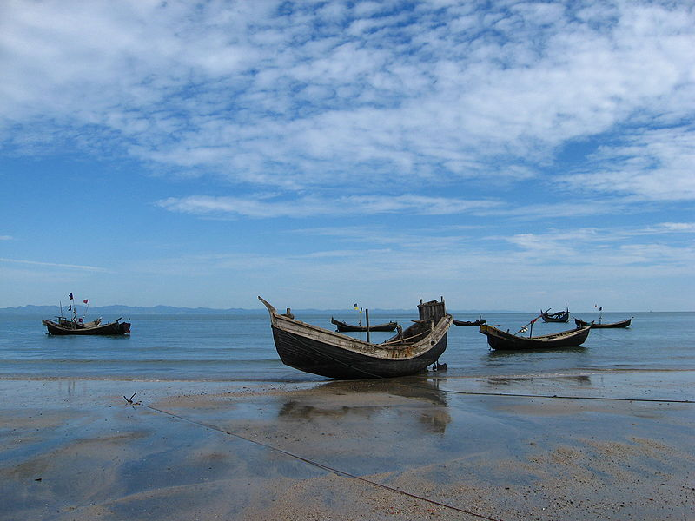
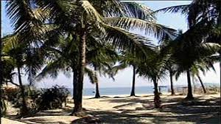
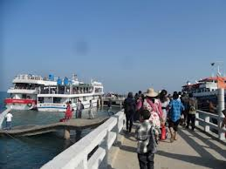
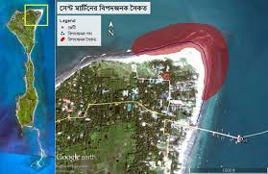
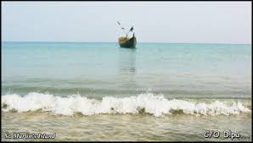
Saint Martin’s Island

Slide 11
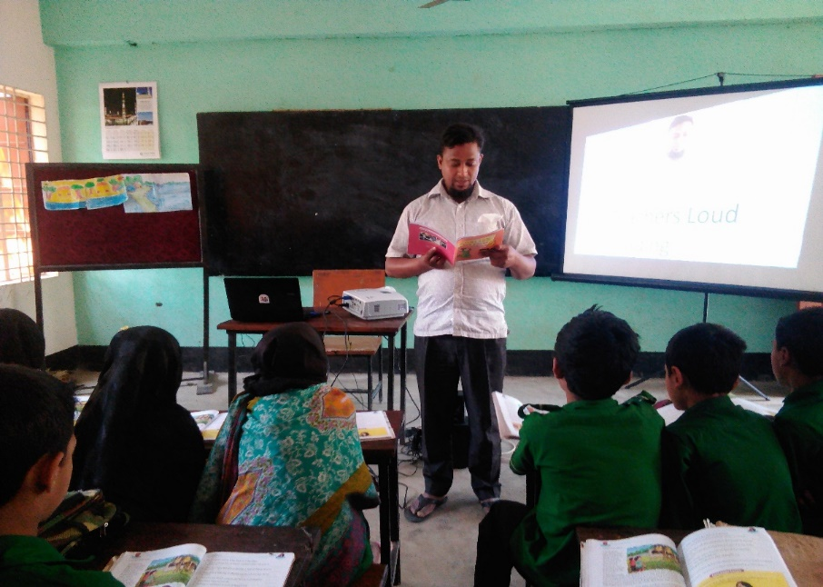
Teachers Loud Reading

Slide 12
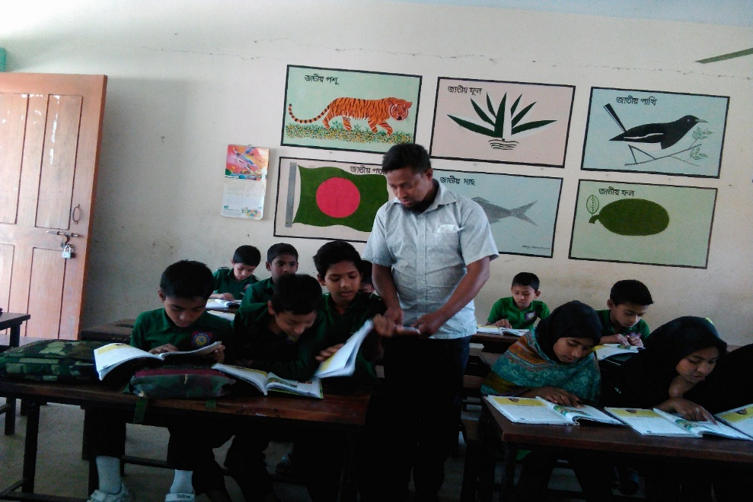
Student loud reading , help by teacher.

Slide 13
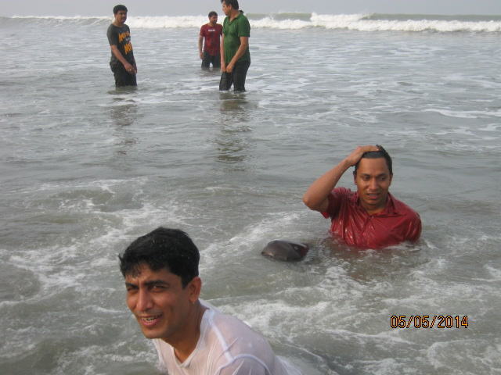
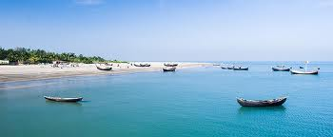
New words and make sentences
Tourist spot :
Interesting place.
Most popular tourist spot is Cox’s Bazar.
Island:
A land all around water.
Saint Martin’s is a Island .
Note: Click on Tourist spot, Island and A land all around water.

Slide 14
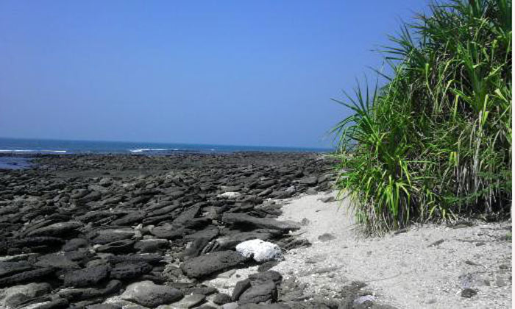
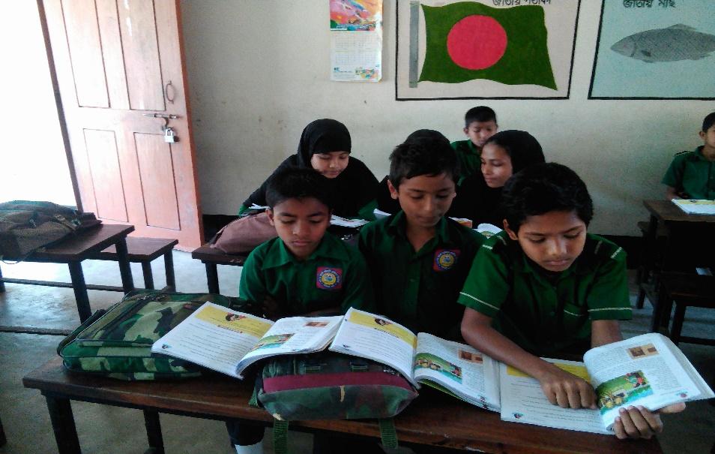

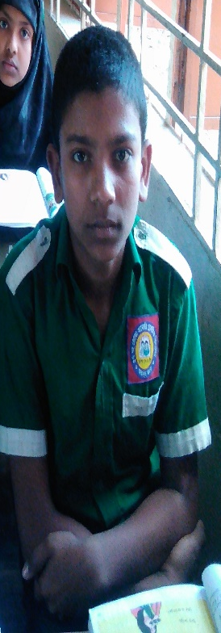
Pair work
Read and act . One is Andy and another is Tamal.
Andy: Hi, Tamal…………….
Tamal: Well, you can also go to the Saint Martin’s Island.

Slide 15
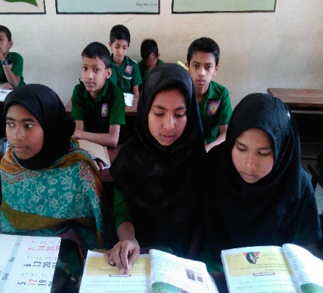
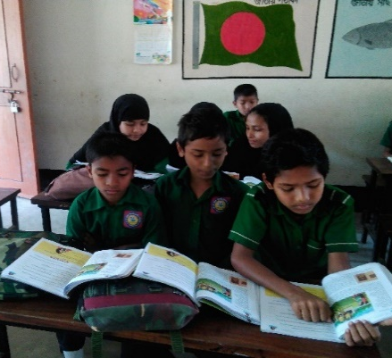

Group work
Note: Click on Group work

Slide 16
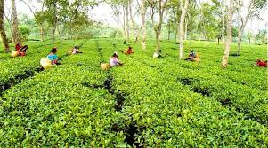
Group: Tea garden
Fill in the blanks
1. I would like to see some new ………. this time.
2. We can see tea garden in ……………
3. We can see……………. In madhabkundu.
Places
Sreemangal
Waterfalls
Note: Click on Group:Tea garden

Slide 17
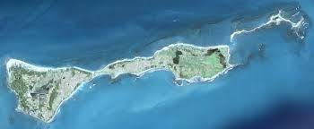
Group: Island
Rewrite Using Capital letter and punctuations
well the most popular tourist spot here is cox’s bazar
Click here for right answer
Well, the most popular tourist spot here is Cox’s Bazar .
Note: Click on Group Island

Slide 18
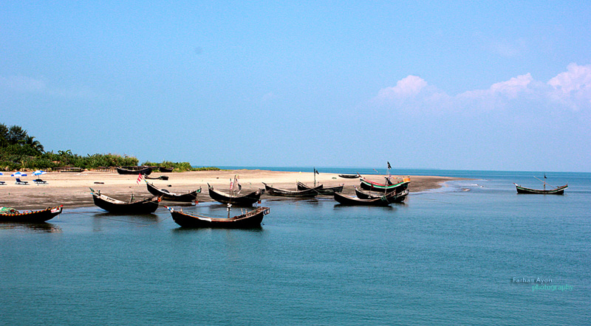
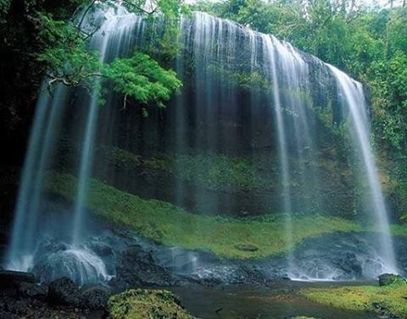
Group: Water falls
Answer the following questions:
What are the main tourist spots in Bangladesh ?
2. What do you see in Srimangal ?
3. What is Saint Martin’s ?
Note: Click on Group Water falls

Slide 19
Evaluation
Right
Try again
Try again
Try again
Try again
Right
*Read and act role of Andy and Tamal.
*Click the right answer
1.Most popular tourist spot is…
a. Cox’s Bazar
b. Srimangal
c. Madhabkundu
2. Who love sea and beach?
a. Tamal
b. Andy
c. Kamal
Note: Click on the right answer, here is surprise

Slide 20
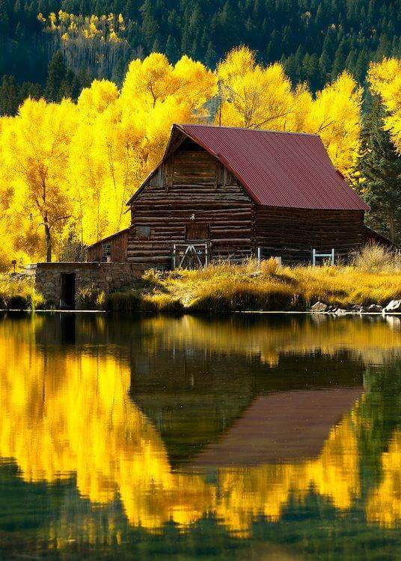
Home work
Write the names of 10 places of tourist attraction in Bangladesh.
Note: Click on Home’s phto

Slide 21
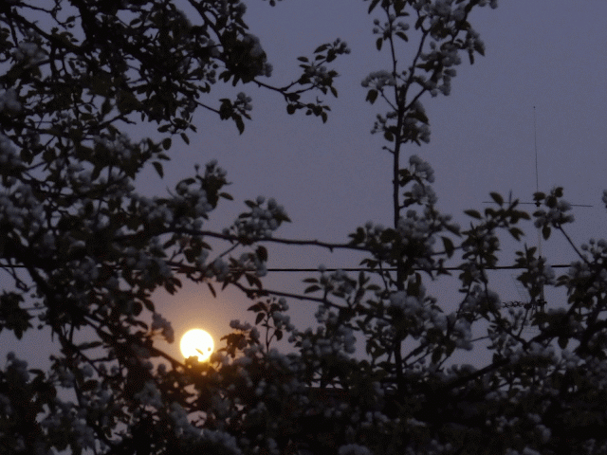
Bye , my dear students. See you next class.

